Slide 1
INTER-AMERICAN DRUG ABUSE
CONTROL COMMISSION
C I C A D
Secretariat for Multidimensional Security
SEVENTIETH REGULAR CICAD SESSION
November 16th-19th, 2021
Virtual Session
OEA/Ser.L/ XIV.2.70
CICAD/doc.2649/21
November 18, 2021
Textual
YORLENY FERRETO
PLENARY SESSION 5, PANEL 5
STRENGTHENING GENDER EQUALITY IN LAW ENFORCEMENT AND THE INTER-AMERICAN PROGRAM FOR STRENGTHENING GENDER EQUALITY IN COUNTERDRUG LAW ENFORCEMENT AGENCIES (GENLEA)

Slide 2
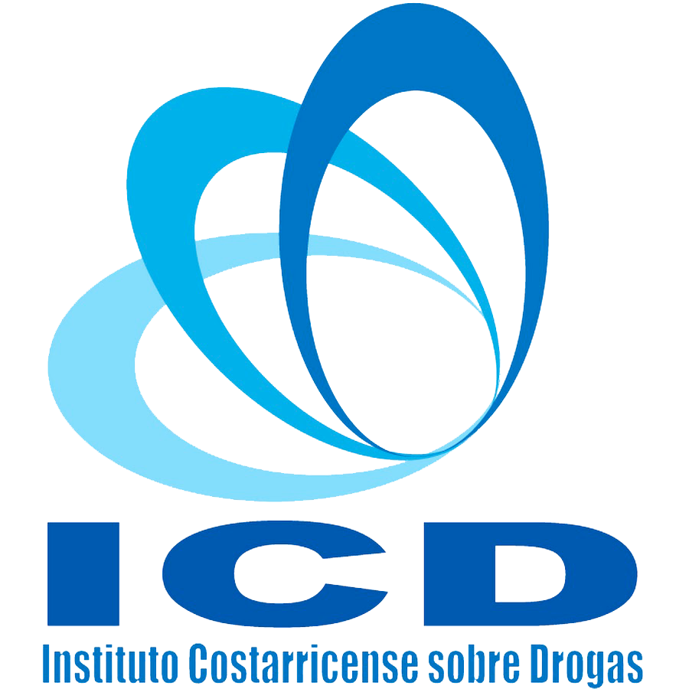
COSTA RICA
Strengthening gender equality in law enforcement and the Inter-American Program for Strengthening Gender Equality in Counterdrug Law Enforcement Agencies (GENLEA)
Marcela Ortiz Bonilla, Deputy Director General, ICD
Yorleny Ferreto Solano, Head, Gender Unit, OIJ
Kerly De Los Ángeles León Alfaro, Head, Gender Office, MSP

Slide 3
Judicial Investigation Authority
(OIJ, by its Spanish language acronym)
An auxiliary, advisory, and consultative organization for jurisdictional judicial authorities. Its mission is to provide assistance in detecting, and the scientific verification, of crimes and their alleged perpetrators.
2016: Gender and Access to Justice Unit
To advise, oversee, and assist in the establishment and implementation of gender equity and equality policies and access to justice policies of the judiciary; for the positive development of all personnel of the institution; and for effective delivery of service of quality to the citizenry, performing humanitarian work, taking as starting point the human sensitivity of the Unit’s personnel and the fundamental rights that assist them.
Works directly with the institution’s upper tiers and with lower organizational ranks.

Slide 4
Quiénes somos
OIJ Best Practices
Gender Diagnostic Assessment or Audit
Development of an Action Plan
Training on sexual harassment:
As a cross-cutting theme in the judiciary of Costa Rica, the requirement has been implemented in the annual operations plans that personnel must receive training on sexual harassment. For that reason, the Gender and Access to Justice Unit in conjunction with the Operational Psychological Support Section

Slide 5
OIJ Best Practices For balance between female and male personnel
Eye-catching recruitment of women
https://sitiooij.poder-judicial.go.cr/index.php/institucion/talento/mujeres-en-la-policia
“Human talent” on the web page has all information required for personnel recruitment is disaggregated, as well as answers to the public’s frequently-asked questions and concerns, and the benefits of joining our police force.

Slide 6
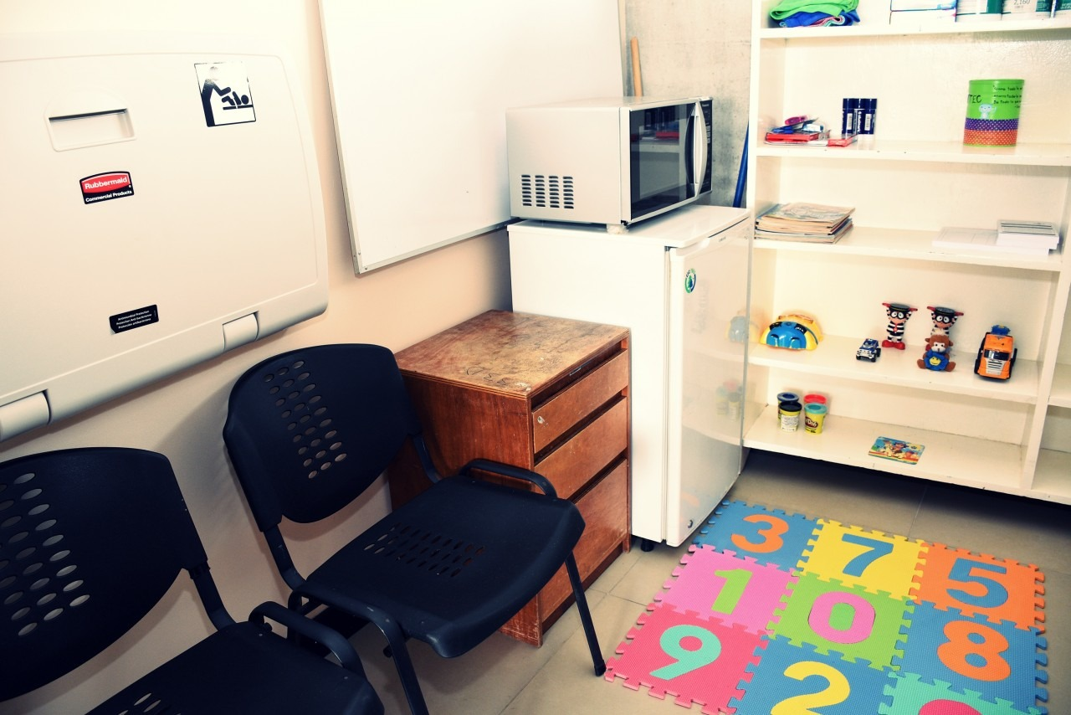
Retention and Integration
Bullet-proof vests and weapons for women have been obtained
Breastfeeding room, OIJ building
Infrastructure improvements
Guaranteeing areas for women and men

Slide 7
OIJ Best Practices
Maternity and paternity
Future actions … where we are going!
Gender awareness and gender-sensitivity training
Profile-raising and recognition
Promoting women’s leadership for access to top-level posts.
Regulations have been issued:
To modify the tasks of pregnant colleagues to safeguard their physical well-being and the higher interests of the child.
To respect the lactation period, the employer allowing the mother a paid hour of leave so that she can exercise her right to breastfeed her child.
Circular 03-DG-2012 and Expansion thereof
Circular 47-DG-2013
Memorandum 79-DG-2016
Bulletin 49-DG-2018

Slide 8
MINISTRY OF PUBLIC SECURITY (MSP) OF COSTA RICA
Mission
To serve and protect in the enjoyment of rights and individual guarantees and to preserve Costa Rican democracy and sovereignty
Gender Equity and Equality Office, MSP:
Gender advisory and oversight body under the Office of the Minister, authorized to contribute to decision-making in the gender area, especially regarding institutional planning and the definition of internal equal opportunity mechanisms for female and male officers, both administrative and police.

Slide 9
OBJECTIVES
MSP Gender
To achieve gender equality through equity in the exercise of the human rights of men and women so as to obtain an institutional culture of peace that enables the MSP’s mission and vision to be implemented and achieved, with the aim of providing optimal service to the Costa Rican community.
Gender Equity and Equality Office, MSP:
To contribute to eliminating the gender gaps existing in the MSP workplace generated by patriarchal socio-cultural patterns, utilizing more and better public policies, regulations, and best practice protocols

Slide 10
BACKGROUND ON GENDER INCLUSION
CREATION OF THE GENDER EQUITY AND EQUALITY OFFICE (OIEG) 2011
GENDER EQUITY AND EQUALITY POLICY 2003
SECOND GENDER EQUITY AND EQUALITY POLICY 2013
CARE FOR FEMALE VICTIMS OF GENDER-BASED VIOLENCE IN THE OIEG
GENDER TRAINING FOR POLICE OFFICERS
SEXUAL HARASSMENT PROTOCOL AND BEST PRACTICES FOR THE PREVENTION OF SEXUAL HARASSMENT
MODIFICATIONS TO THE PROVISIONING OF WOMEN, VESTS, UNIFORMS, AND REGULATIONS ON ROLES AND UNIFORM USE
CREATION OF SPECIAL UNITS FOR VIFA CARE FOR RESPONSE AND SERVICE TO THE COMMUNITY
PROJECT TO UPDATE THE GENDER EQUITY AND EQUALITY POLICY 2022 -2030
MODIFICATION OF REGULATIONS TO INCLUDE NORMS ON PREGNANT WOMEN AND LACTATION PERIODS. CIRCULARS ON THE LGBTIQ+ POPULATION

Slide 11
WHAT WE HAVE ACHIEVED SINCE OBTAINING THE GENLEA MANUAL
GENLEA MANUAL
CIRCULARS WITH GUIDELINES BASED ON GENLEA FINDINGS
IMPLEMENTATION MATRIX
INCLUSIVE NON-SEXIST LANGUAGE HANDBOOK
WOMEN’S EMPOWERMENT PROCESSES
FEMALE POLICE MENTOR GROUP
MINI PREVENTION CAMPAIGNS
GENDER GAP STUDY
INFORMATION COMPILATION
(GENLEA IMPLEMENTATION MATRIX)
VISUALIZATION AND RAISING AWARENESS OF THE NEED FOR MORE AND BETTER GENDER EQUALITY PRACTICES IN THE INTERNAL AREAS OF THE MSP
TRAINING FOR PEACE OPERATORS [GESTORES (AS) DE PAZ]
GENLEA MATRIX ENABLES NEW GENDER GUIDELINES TO BE CREATED FOR BETTER STRATEGIC ACTION TO BRIDGE THE GENDER GAP IN THE MSP
The first time that internal areas report implementations in the gender area

Slide 12
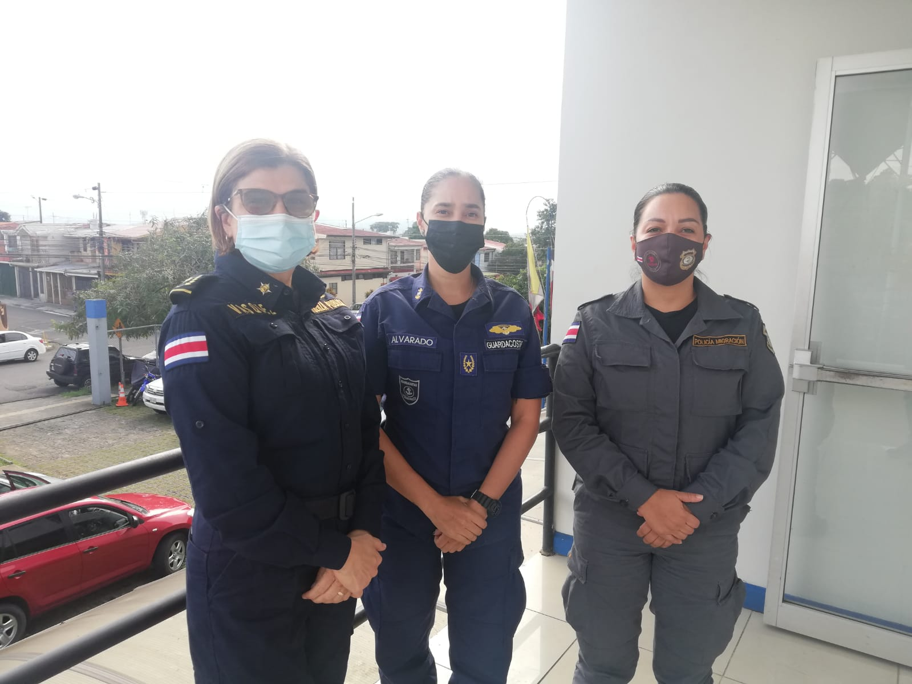
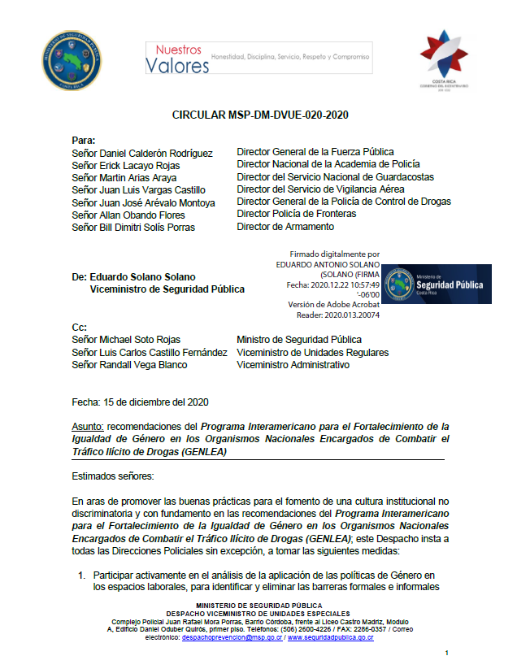
GENLEA MSP Circulars

Slide 13
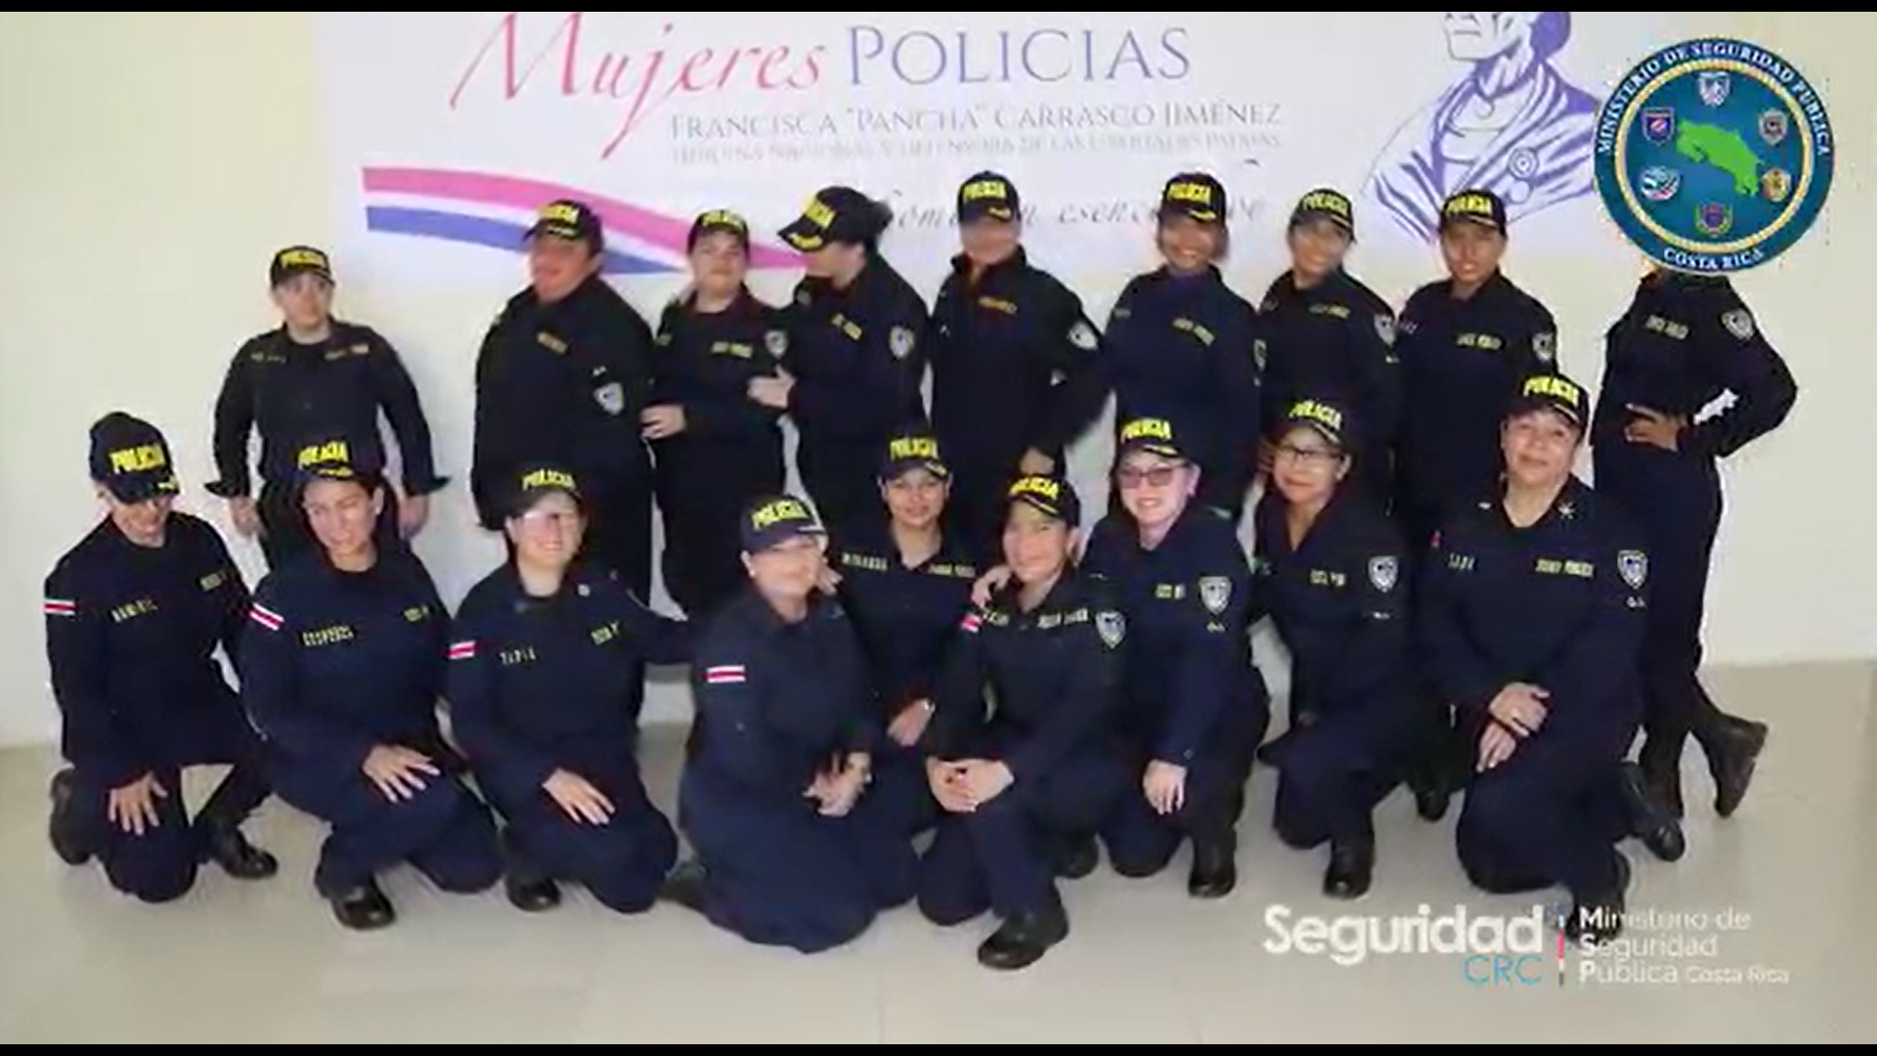
Meetings of Female Police Officers: Pancha Carrasco
Sorority forums
Women’s empowerment
Mentoring program

Slide 14
Awareness
Challenges faced
by the MSP
Forms of neomachismo
Reconciling work and family
Positive masculinities
Sorority
Empowerment
Making police work more attractive to women

Slide 15
GENLEA ACTION PLAN 2022-2024 COORDINATION among the Costa Rican Drug Institute (ICD, by its Spanish language acronym), the OIJ, and the MSP
To promote and support the process of changing the institutional culture to strengthen gender equality and workplace relations for equal workplace rights and opportunities for women and men in the police forces of Costa Rica that combat illicit drug trafficking.
Ministry of Public Security (MSP), Judicial Investigation Authority (OIJ), and Costa Rican Drug Institute (ICD).

Slide 16
GENLEA ACTION PLAN 2022-2024 ICD-OIJ-MSP COORDINATION
Training on inclusive gender perspective
Awareness campaigns and empowerment of female and male police officers regarding masculinities for equality
Coordination of an interinstitutional conference: “National Conference on gender equality in the police institutions of Costa Rica”

Slide 17
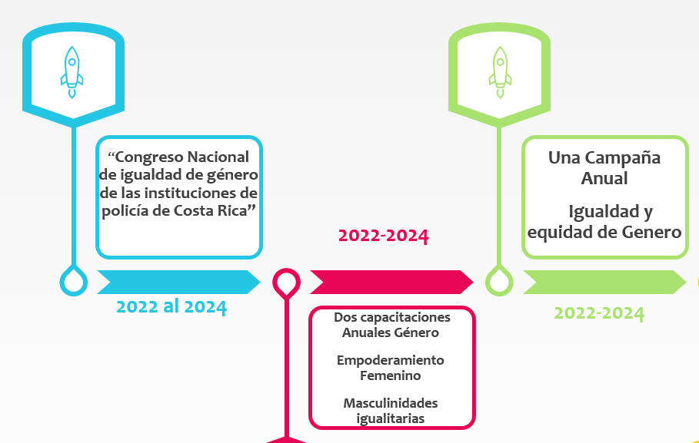
GENLEA ACTION PLAN 2022-2024 ICD-OIJ-MSP COORDINATION

